Slide 1
State of Hepatitis C in Ghana
Dr. Fred Stephen Sarfo
(MD, FWACP, PhD)
Dept Internal Medicine, KATH

Slide 2
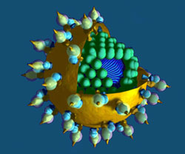
HCV in Ghana

Slide 3
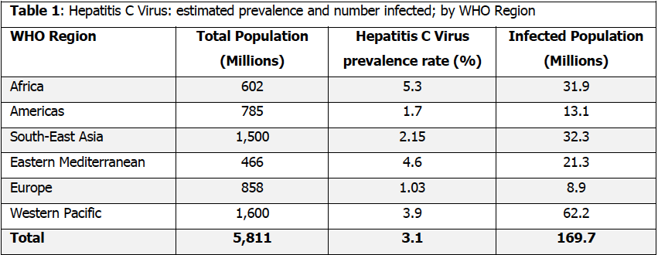
HCV in Africa
Karoney et al., 2013

Slide 4
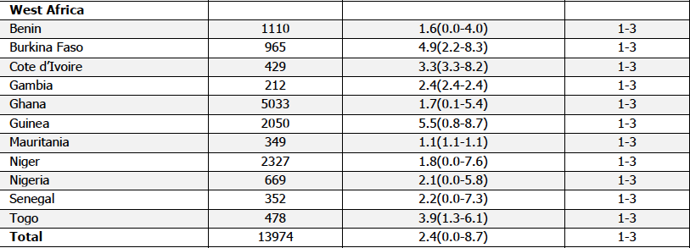
HCV in West Africa
Karoney et al., 2013

Slide 5
Sero-prevalence of HCV in Ghana
PUBMED Search, 33 articles
Excluded 17 articles
Included 16 articles
Blood donors, n=9 studies
Prisons, n=3 studies
Obstetrics & Gynae, n=3 studies
HIV naïve, n=1 study
School children, n=1 study
Excluded 2 studies

Slide 6
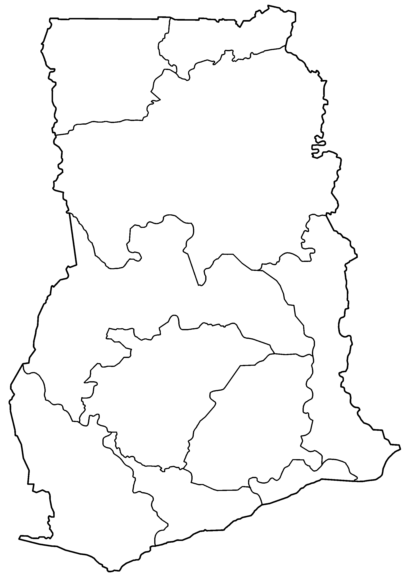
Sites with HCV studies conducted

Slide 7
Sero-prevalence of HCV in Ghana
Study No. | First Author | Year | Location | Population | Sample size | HCV Ab frequency
1 | Kubio C | 2012 | Damango, NR | Blood donors | 819 | 6.1%
2 | Sagoe KW, | 2012 | KBTH, GAR | HIV Naive | 138 | 3.6%
3 | Nkrumah B | 2011 | Ashanti Akim N. AR | Blood doors | 2773 | 9.4%
4 | Allain JP | 2009 | KATH, AR | Blood donors | 51,000 | 0.45%
5 | Adjei AA | 2007 | Multicentre | Prison inmates | 1336 | 18.7%
6 | Apea-Kubi | 2006 | KBTH, GAR | OB & GY OPD | 638 | 5.2%
7 | Adjei AA | 2006 | Multicentre | Prisons inmate Prison officers | 218 82 | 19.2% 23.2%
8 | Lassey AT | 2004 | KBTH, GAR | OB & GY delivery | 638 | 2.5%
9 | Candotti D | 2003 | KATH, AR | Blood donors | 4,984 | 1.3%
10 | Ampofo W | 2002 | NMIMR, GAR | Blood donors | 808 | 8.4%
11 | Sarkodie F | 2001 | KATH, AR | Blood donors | 45,000 | 0.3%
12 | Acquaye JK | 2000 | KBTH, GAR | Blood donors | 1,300 | 5.2%
13 | Candotti D | 2001 | KBTH, AR | BD Replacement BD volunteers | 1,569 1,169 | 1.7% 0.7%
14 | Martinson | 1996 | Ashanti Akim N. AR | School children | 803 | 5.4%
Total |  |  |  |  | 113,154 | 1.2%

Slide 8
Sero-prevalence among specific populations
Population | Number of studies | Sample size | Average HCV Ab frequency | Range
Prisons | 3 | 1,636 | 19.0% | 18.7% - 23.2%
School children | 1 | 803 | 5.4% | 5.4%
OB & GY | 2 | 1,155 | 3.7% | 2.5% - 5.2%
HIV Naïve | 1 | 138 | 3.6% | 3.6%
Blood donors | 9 | 109,422 | 0.8% | 0.7% - 9.4%

Slide 9
Risk factors in Ghana
Adjei et al. (2007), identified the following risk factors among prison inmates
Risk factor | Adjusted OR | 95% CI
Longer incarceration > median time served of 36 months | 5.8 | 5.0 – 6.9
Hx of IV drug use | 4.5 | 3.8 – 5.4
Homosexuality | 3.1 | 2.5 – 3.9

Slide 10
Risk factors in Ghana
Adjei et al. (2008) identified the following among prison inmates/officers:
Age 17-46 years
Female gender
Being unmarried
Hx of sexually transmitted diseases
Hx of participation in paid sexual activity
Hx of sharing in drug paraphernalia

Slide 11
Genotypes of HCV in Ghana
There are 6 phylogenetic distinct genotypes:1-6
Many subtypes: a, b, c
100 different strains: 1,2,3 etc based on the sequence of the HCV genome
Genotypes 1-3 have world-wide distribution
In Ghana, genotype 2 (87%) is commonest, genotype 1 (13%)
(Wansbrough-Jones et al., 1998; Candotti et al.2003)

Slide 12
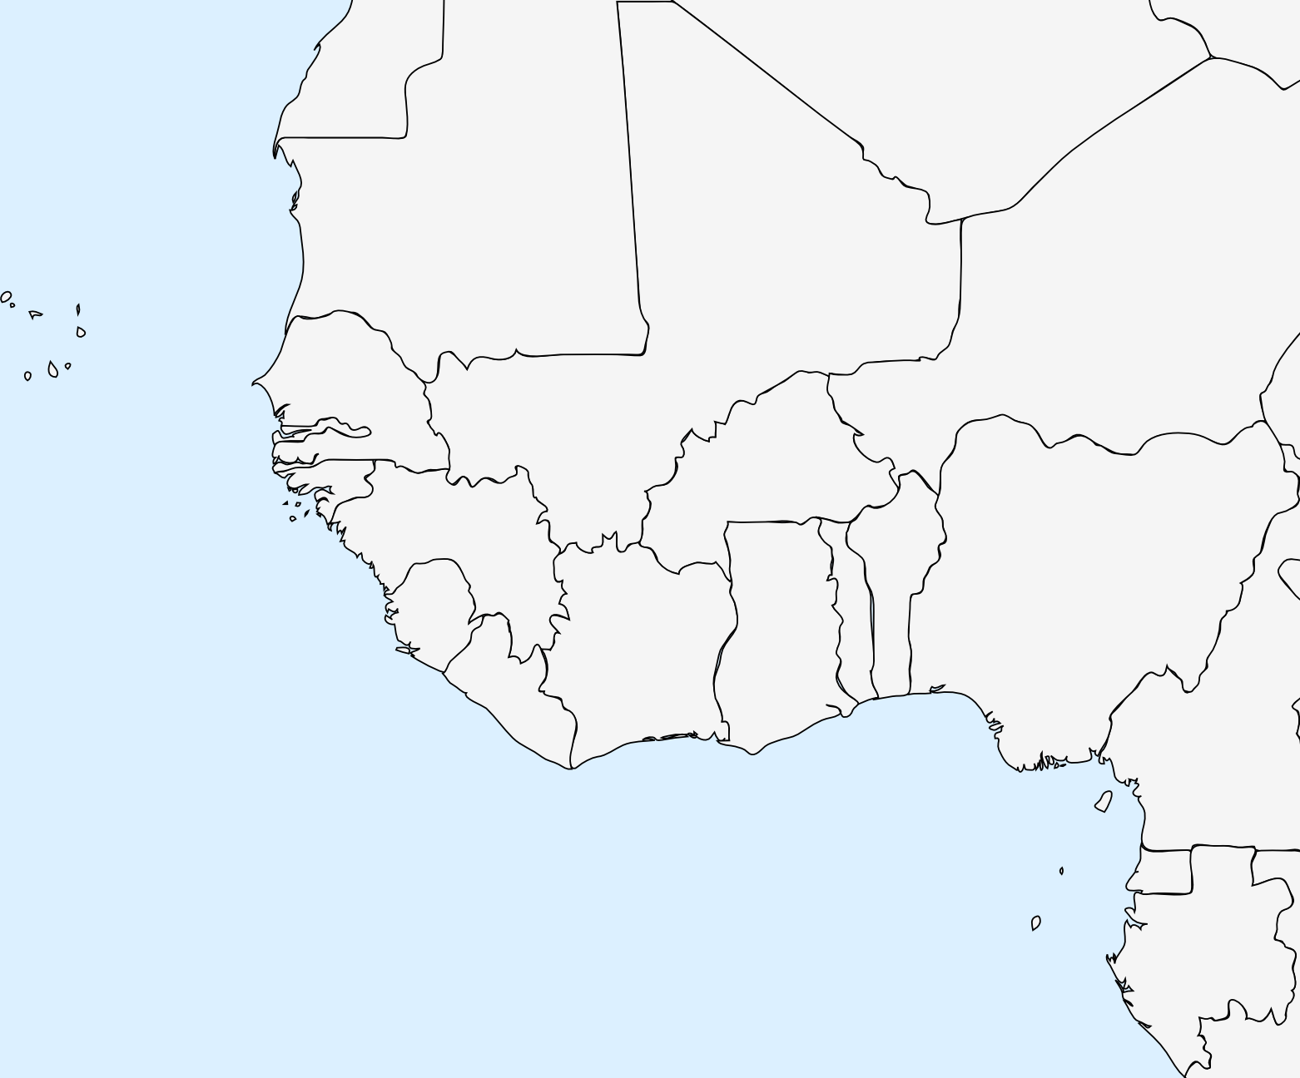
Clades/Subtypes of HCV genotype 2
4
3
2
1

Slide 13
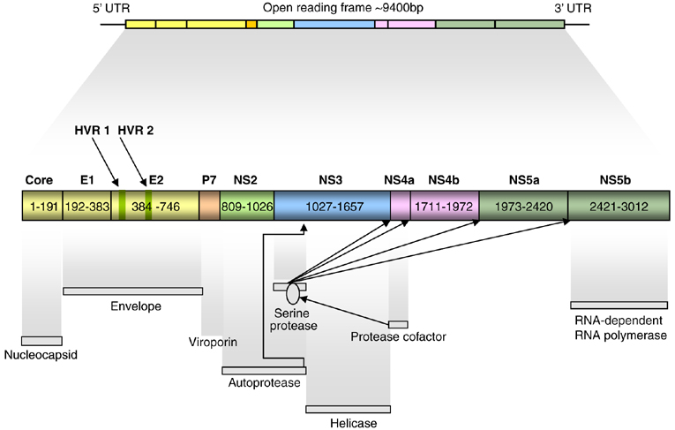
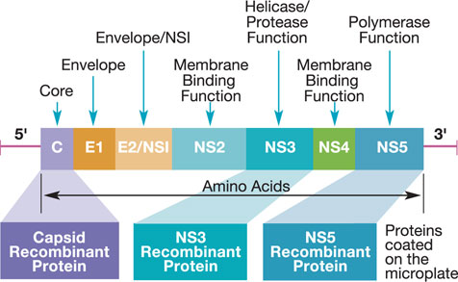
Genetic diversity

Slide 14
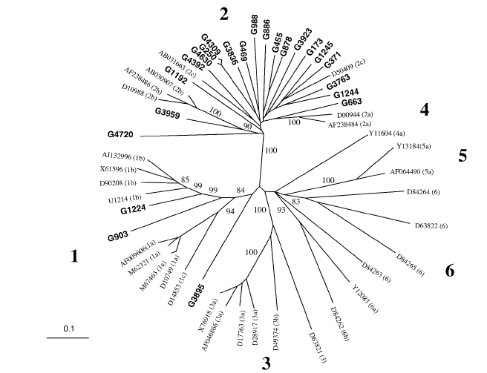
Phylogenetic relationship between HCV E1/E2 sequences in 23 Ghanaian strains and 31 reference sequence
Candotti et al. 2003

Slide 15
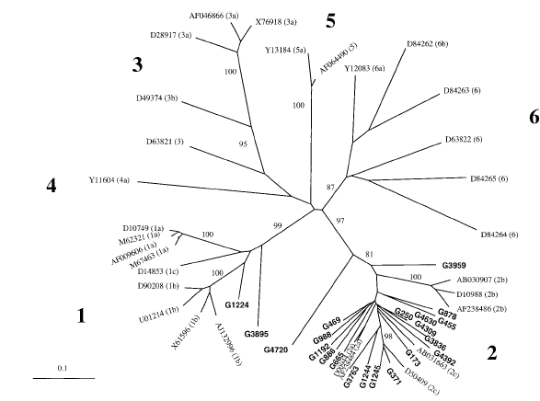
Phylogenetic relationship between HCV NS5B sequences in 23 Ghanaian strains and 31 reference sequences
Candotti et al. 2003
Notes:
Genetic diversity in both the hypervariable E1/E2 and also the more conserved NS5B regions.
No distinct sub-type either for genotype 1 or 2.
Genotype 2 subtypes are geographically restricted- 2a-East Asia, 2b- Northern America, 2c- Europe. None of these subtypes identified in Ghanaian and West African strain. 2 intepretations
Recent and rapidly expanding epidemic of HCV in Ghana leading to faster evolution than average genotypes
Ancient endemicity of HCV type 2 in Ghana and West Africa leading to the emergence of an undifferentiated multiplicity of subtypes over a long-term evolution process.

Slide 16
Disease progression and presentation

Slide 17
Disease progression and presentation
HCV disease progression not well studied in Ghana
Clearance driven by viral and host factors
Likely that there is higher spontaneous clearance of genotype 2 among Ghanaians.
Candotti et al. reported that at least 53% of anti-HCV carriers had no detectable HCV RNA among blood donors

Slide 18
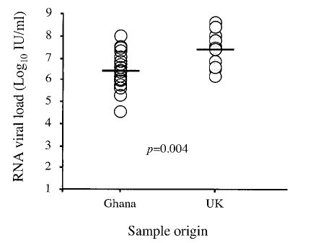
Disease progression and presentation
Ghanaian viremic HCV blood donors had significantly lower viral loads than UK cohort

Slide 19
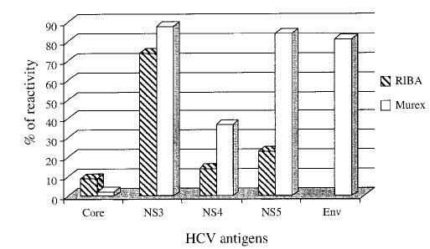
Disease progression and presentation
Host factors important in clearance of HCV are humoral and cellular immunity
Notes:
Strong antibody (humoral) responses to several antigens by Ghanaian patients who were aviremic but sero-positive.

Slide 20
Cellular immunity and host genetics
Cheung et al. studied the cellular immune response to HCV among Ghanaians using ELISPOT and found ff responses
12 / 24 (50%) confirmed recovered
1 / 5 (20%) chronically infected
0 / 6 (0%) false positive
HLA-B*57 was more frequent among those recovered than chronically infected (OR=8.02, p=0.005)

Slide 21
Clinical presentation
What is the prevalence of HCV among individuals with
Transaminitis (2 out of 68 with HCV Ab).Acquaye et al.
Liver cirrhosis
Hepatocellular carcinoma
Chronic kidney disease
HIV co-infected patients
Hepatotoxicity on ART and Anti-TB medications
Patients on dialysis

Slide 22
Management of HCV infection
Indications for treatment
All patients with HCV are potential candidates for treatment
Those at risk of developing cirrhosis evidenced by
Measurable HCV RNA viral load and liver biopsy showing portal or bridging fibrosis along with moderate inflammation and necrosis.

Slide 23
Recommended treatment regimens for HCV infection
 | Medication | Dose | Duration
Acute infection | Interferon (IFN) | 6MU IM/SC x 3/week | 36 weeks
 | PEG Interferon | 180 mcg weekly | 48 weeks
Chronic infection | Interferon | 3MU IM/SC x 3/week | 24 months
 | Ribavirin | 800-1200mg PO bd | 24-48 weeks
Newer agents such as Sofosbuvir, Boceprevir and Telaprevir not available. They could be studied in this population to assess their efficacy
Treatment outcomes of HCV in Ghana not well described

Slide 24
Research questions for HEPNet
There is a clear need for an integrated approach to HCV research in Ghana (Africa)
We need to understand
Transmission
Prevalence in the community
Natural history of HCV genotype 2
Host and genetic factors involved in HCV pathogenesis
Burden of disease
Impact on HIV outcomes
Treatment outcomes
Test newer agents on pilot basis to assess their efficacy

Slide 25
Thank you for your attention

